Slide 1
Talk Data to Me!
Jackson

Slide 2
Data Driven Instruction
*Wanted to move Novice students up at least one level on math KPREP test
*Needed research based strategies to individualize instruction

Slide 3
What’s the link?
*Between IXL and MAP
*Between IXL and KPREP

Slide 4
How I Used the Data
*Other school districts had already linked MAP scores with IXL skills
*Used that information with my own research to assign certain students to skill sets based on their lowest math strand on MAP test
*Assigned 10 individualized skill sets per student per quarter

Slide 5
Research
*Created a control group that did not receive skill sets
*Set previous year KPREP scores as baseline for both groups
*Tracked KPREP math scores for intervention and control groups

Slide 6
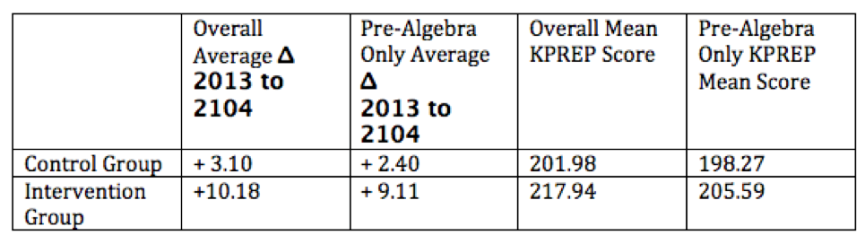
Findings

Slide 7
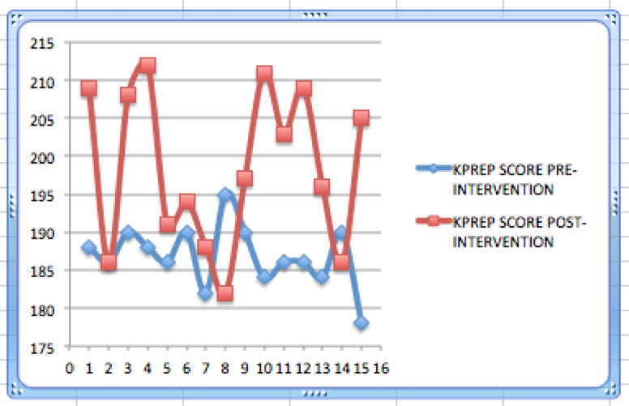
Novice Pre and Post Intervention

Slide 8
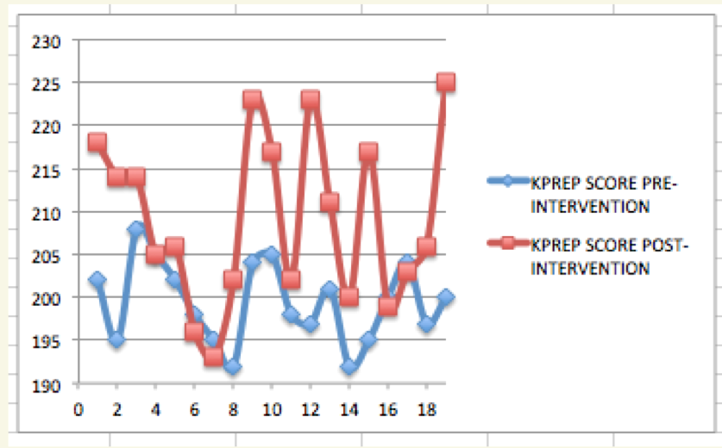
Apprentice Pre and Post Intervention

Slide 9
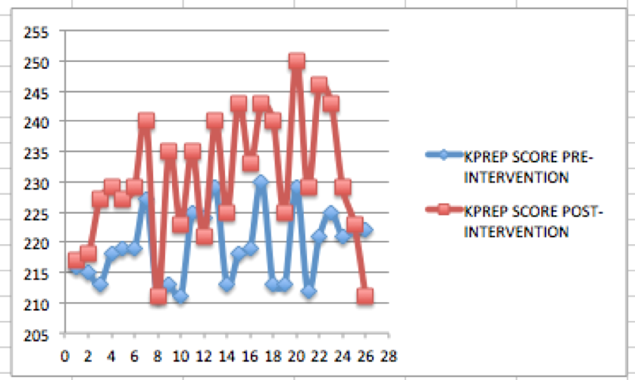
Proficient Pre and Post Intervention

Slide 10
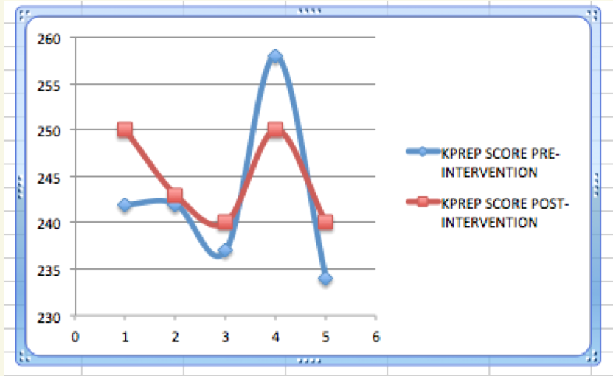
Distinguished Pre and Post Intervention

Slide 11
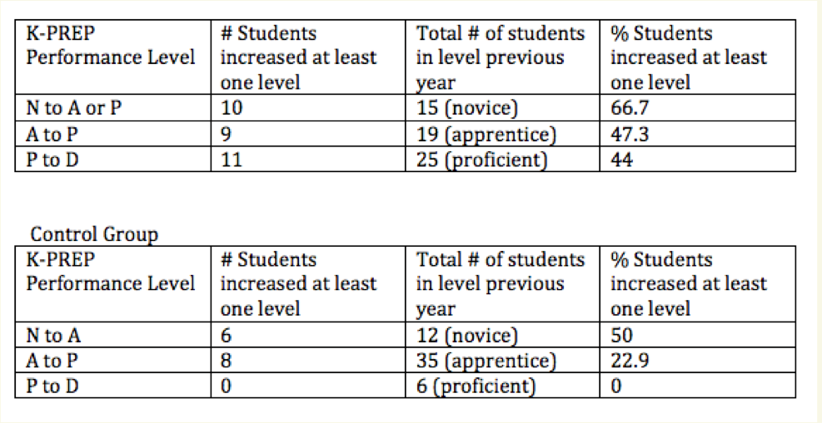
Intervention vs. Control

Slide 12
Exciting Results!
*This intervention worked.
*Set up a goal sheet with each student and conference with each student on a quarterly basis to have an even deeper impact on their learning.
*Keep one sheet for each student in binder
*Student keeps one sheet in his/her own binder on front page for constant reminder of goals

Slide 13
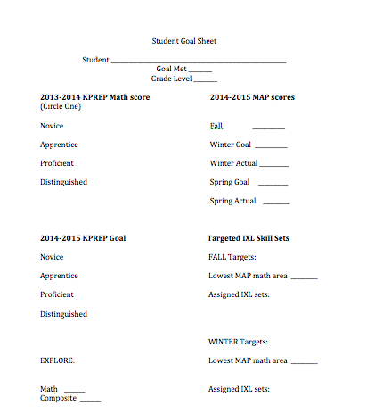
Goal Sheet

Slide 14
Data collection continues…
*I continuously collect data on my students and allow it to guide my instruction.
*What questions do you have about data collection or using goal sheets?

